Slide 1
Credit Card Fraud Detection: Capstone Project (DA) By : Meenakshi Sharma sindhu l Dhemath Dhanraj

Slide 2
agenda
Introduction
Problem Statement
Objective & Key Goals
Overview Of Data
Insights
Model Evaluation
Cost-benefit analysis
Conclusion & Business Recommendation

Slide 3
Introduction
Credit card fraud is any dishonest act or behaviour to obtain information without the proper authorisation of the account holder for financial gain.
Among the different ways of committing fraud, skimming is the most common one. Skimming is a method used for duplicating information located on the magnetic stripe of the card.
Apart from this, other ways of making fraudulent transactions are as follows:
Manipulation or alteration of genuine cards
Creation of counterfeit cards
Stolen or lost credit cards
Fraudulent telemarketing

Slide 4
Problem Statement
In the banking industry, detecting credit card fraud using machine learning is not just a trend; it is a necessity for banks, as they need to put proactive monitoring and fraud prevention mechanisms in place.
Machine learning helps these institutions reduce time-consuming manual reviews, costly chargebacks and fees, and denial of legitimate transactions.

Slide 5
Objective & Key goals
Objective:
Develop a machine learning model to detect fraudulent transactions using historical transactional data with a pool of merchants.
Key Goals:
Analyze the business impact of fraudulent transactions.
Recommend cost-effective strategies to mitigate fraud risks.

Slide 6
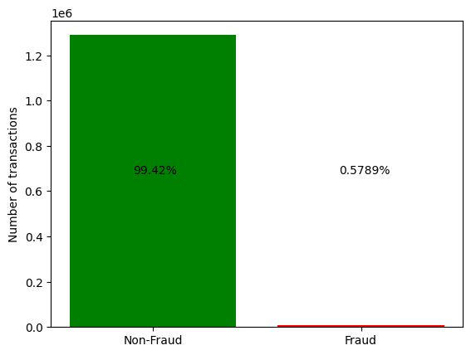
Overview of data
Fraud data = 7506 Transactions (0.5789%)
Non-Fraud data = 1289169 Transactions (99.42%)

Slide 7
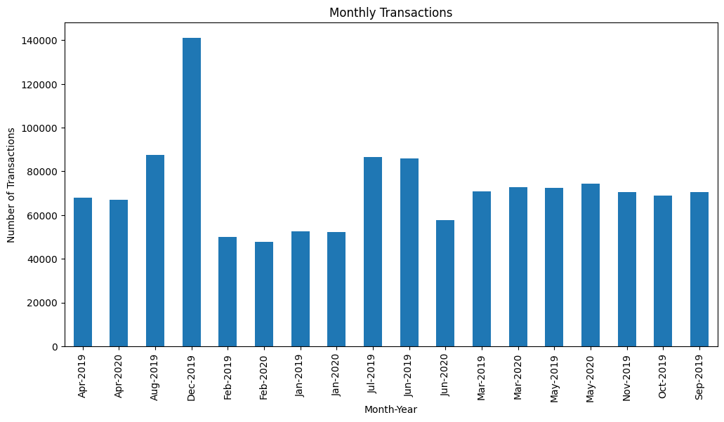
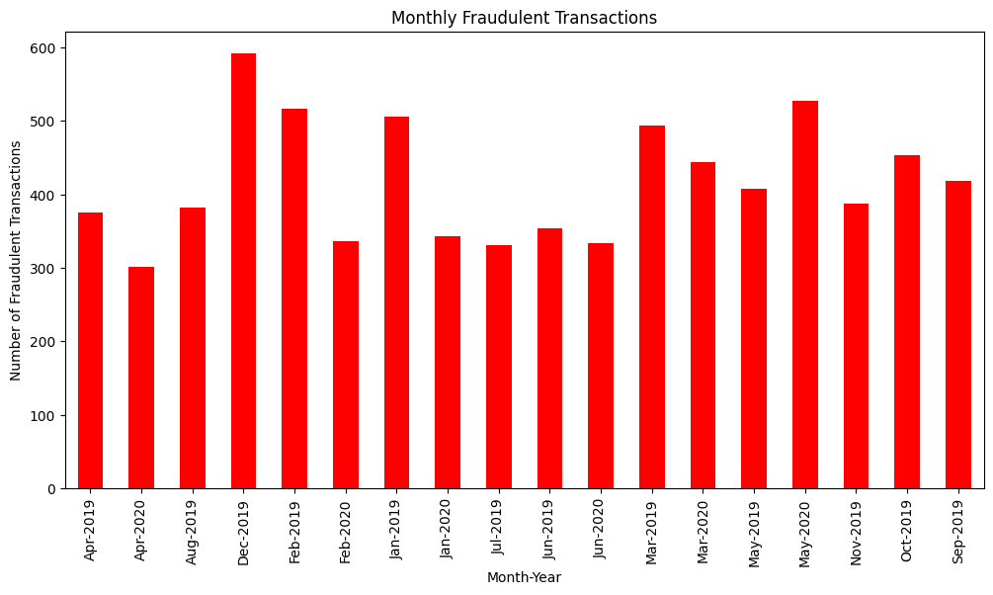
Visual representation of frequency of transactions and Fraudulent transactions
*See insights in next slide

Slide 8
Insights from frequency of transactions and Fraudulent transactions
Overall Transaction Trends:
December 2019: Reported the highest number of transactions, exceeding 140,000.
Fluctuations: Monthly transaction counts varied, with peaks in August 2019 and January 2020.
Fraudulent Transaction Patterns:
December 2019: Also saw the highest number of fraudulent transactions, reaching around 600.
Significant Variations: Peaks observed in December 2019, January 2020, and May 2020.

Slide 9
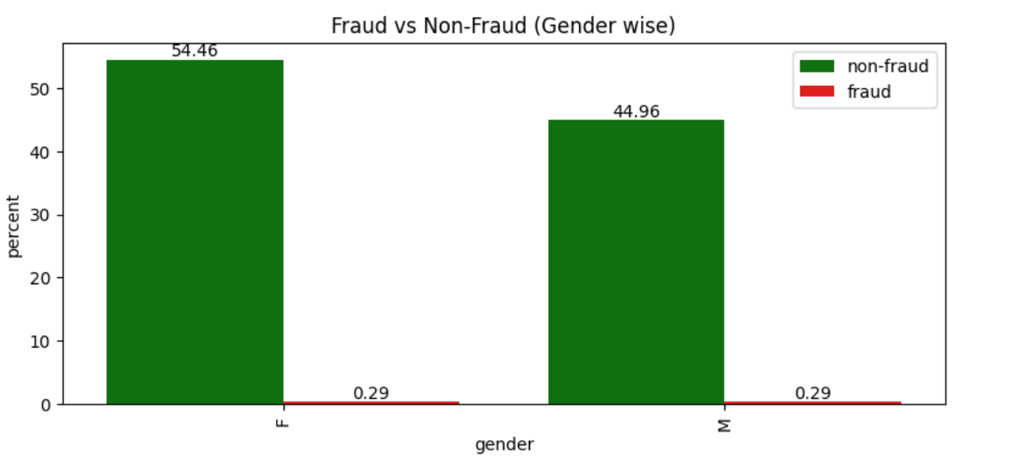
Fraud vs Non-fraud(gender wise)
Non-fraudulent activities are notably higher among females (54.46%) compared to males (44.96%).
The fraud rate is consistently low and equal for both genders at 0.29%.

Slide 10
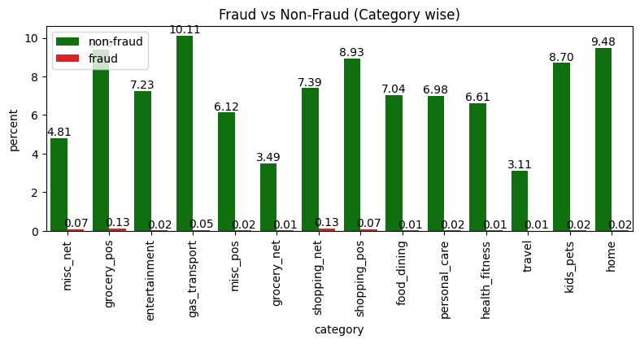
Fraud vs Non-fraud (category wise)
Gas_transport and Grocery Point of Sale (grocery_pos) categories show the highest percentages of non-fraudulent transactions, exceeding 10%.
Shopping Point of Sale (shopping_pos) has a notably higher fraud occurrence, around 0.14%, followed by other categories averaging 0.13% fraud.
Entertainment and Home categories demonstrate very low fraud percentages, suggesting they are less susceptible areas.

Slide 11
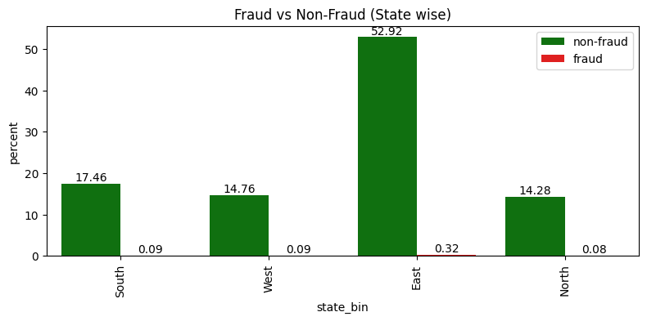
Fraud vs Non-fraud (state wise)
East Region: Dominates in both non-fraud (52.92%) and the highest fraud percentage (0.32%)
South and West Regions: Both show relatively lower non-fraud percentages (17.46% and 14.76%) and identical fraud percentages (0.09%).
North Region: Registers the lowest non-fraud (14.28%) and fraud (0.08%) percentages compared to other regions.

Slide 12
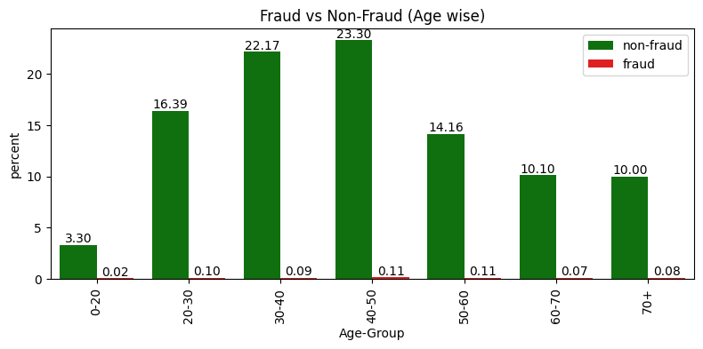
Fraud vs Non-fraud (age wise)
Middle-Aged Focus: Middle-aged individuals (30-50) exhibit the highest number of transactions, both fraudulent and non-fraudulent.
Young Adults and Seniors: Have relatively fewer transactions yet still show some instances of fraud.

Slide 13
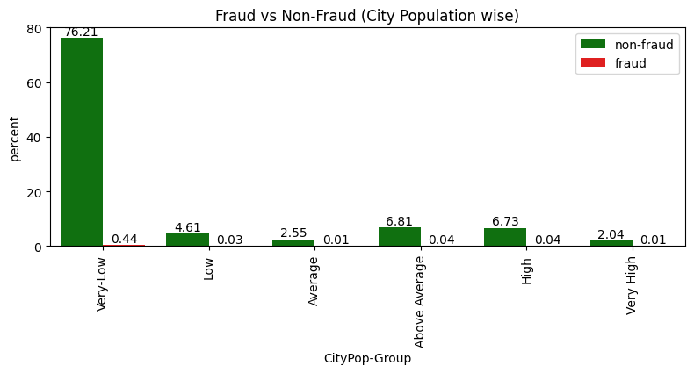
Fraud vs Non-fraud (city population wise)
Very-Low Population Cities: Show the highest activity for both non-fraudulent and fraudulent transactions, indicating a need for fraud monitoring and preventive measures in these locations.
Consistency Across Other Groups: Fraud remains relatively low in Low, Average, Above Average, High, and Very High population groups but warrants attention due to non-zero occurrences.

Slide 14
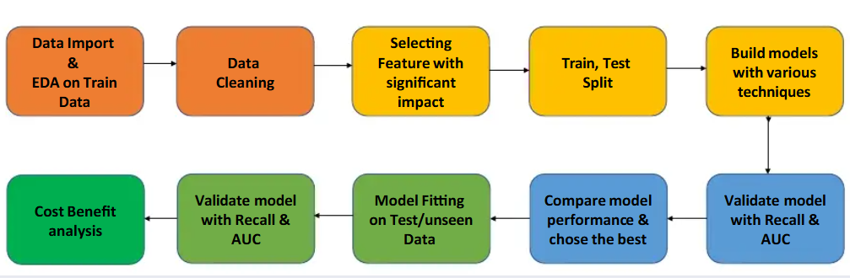
Flow Chart of modelling

Slide 15
Model evaluation
Model | Accuracy | Precision | Recall | F1_Score | ROC_AUC
Logistic Regression (Adasyn) | 78.5% | 1.4% | 76.0% | 2.7% | 86.7%
Decision Tree (Smote) | 96.7% | 10.0% | 94.8% | 18.0% | 97.9%
Decision Tree (Adasyn) | 92.4% | 4.5% | 93% | 8.7% | 97.2%
Decision Tree (Hypertuning with smote) | 96.7% | 9.9% | 94.2% | 18.0% | 96.9%
Random Forest (Smote) | 98.9% | 25.2% | 88.1% | 39.2% | 98.9%
Random Forest (Adasyn) | 97.2% | 11.3% | 91.0% | 20.0% | 98.7%

Slide 16
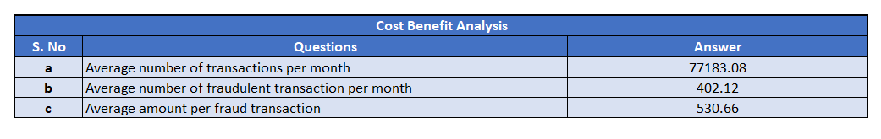
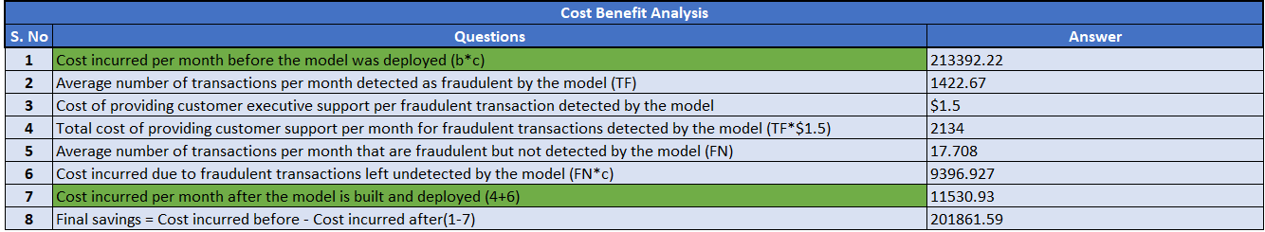
Cost benefit analysis

Slide 17
Conclusion & Recommendation
Modelling Techniques Performed: Logistics Regression with ADASYN sample, Decision Trees with SMOTE and ADASYN Sample, Hypertuned Decision Trees with SMOTE sample, Random Forest Classifier with SMOTE and ADASYN sample. After performing various modelling technique , we conclude Random Forest Classifier with SMOTE sampling works better with better F1-Score and Recall values. So choosing Random Forest SMOTE analysis for Cost-Benefit Analysis.
After the model is deployed Bank's final savings were amounted to dollar ‘$201861'
East Region: Highest in transaction activity, with a noticeable differential in fraud cases, indicating a potential focus area for enhanced fraud detection mechanisms.
Fraudulent activities are generally low but vary across categories, highlighting particular areas (like shopping_pos) requiring more stringent monitoring.
Focus on implementing targeted fraud prevention strategies, particularly in very-low-population cities, while maintaining vigilance across all population groups.

Slide 18
Submission Video
The submission video file exceeds the allowed limit of 50 MB to upload on Upgrad learn portal, hence the video has been uploaded to Google drive. Kindly access the video file using below link:
Video : https://drive.google.com/file/d/10gKkwMYJNiKa_Uq5qIM7Rrfs3gVd74kP/view?usp=sharing

Slide 19
Thank you

